Slide 1
Hostel management system

Slide 2
Study Of Current System-
Current System of Hostel Management is fully based on paperwork. Hostel Management has to manage all
records of students and rooms on paper.

Slide 3
Problem and Weakness Of Current System-
Paperwork is a tedious job. There can be delay and the problem of human error in allocating rooms and providing resources.

Slide 4
Proposed System:
Proposed system is the computerized version of the existing system which provides easy and quick access over the data.
Keeping the records of admission of Students properly so that
facilities provided by Hostels are fully utilized in effective and
efficient manner.

Slide 5
Advantages:
Integration: Records can be integrated with digital systems and made readily discoverable within digital catalogs.
Disaster recovery: Paper records are vulnerable to many risks. Digital copies ensure information remains retrievable if a site disaster leads to the loss of analog formats.
Less Time-consuming.
Maintain accuracy.

Slide 6
The project, Hostel Management System is a desktop-based application that allows the hostel manager to handle all hostel activities.
Interactive GUI and the ability to manage various rooms make this system very flexible and convenient.

Slide 7
Tools used
User Interface: The User interface required to be developed for the system should be user-friendly and attractive.
There are two sets of java APIs for graphics programming:
AWT (Abstract Windowing Toolkit) and Swing.

Slide 8
AWT API was introduced in JDK 1.0. Most of the AWT components have become obsolete and should be replaced by newer Swing components.
Swing API, a much more comprehensive set of graphics libraries that enhances the AWT, was introduced as part of Java Foundation Classes (JFC) after the release of JDK 1.1. JFC consists of Swing, Java2D, Accessibility, Internationalization, and Pluggable Look-and-Feel Support APIs. JFC was an add-on to JDK 1.1 but has been integrated into core Java since JDK 1.2.

Slide 9
Software Interfaces
Programming Language: Java
Connection: Mysql-installer-web-community-8.0.31.0
Back End Tool : Mysql 5.5 command line client

Slide 10


Slide 11
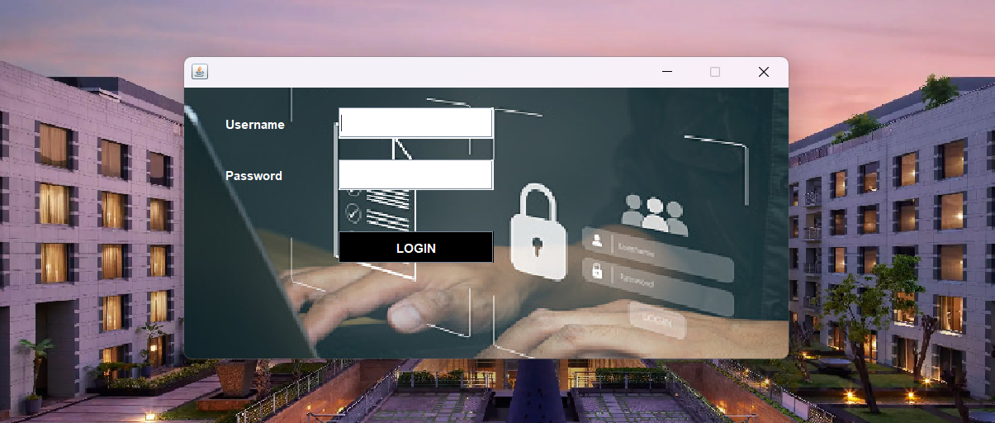
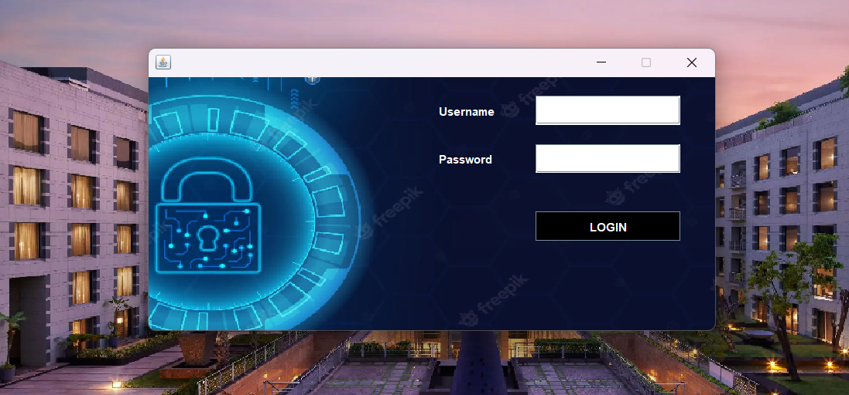

Slide 12


Slide 13
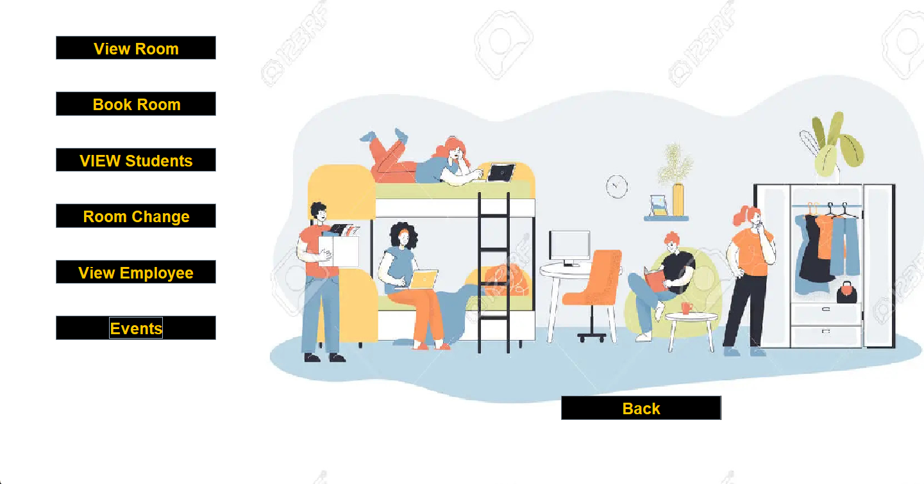

Slide 14
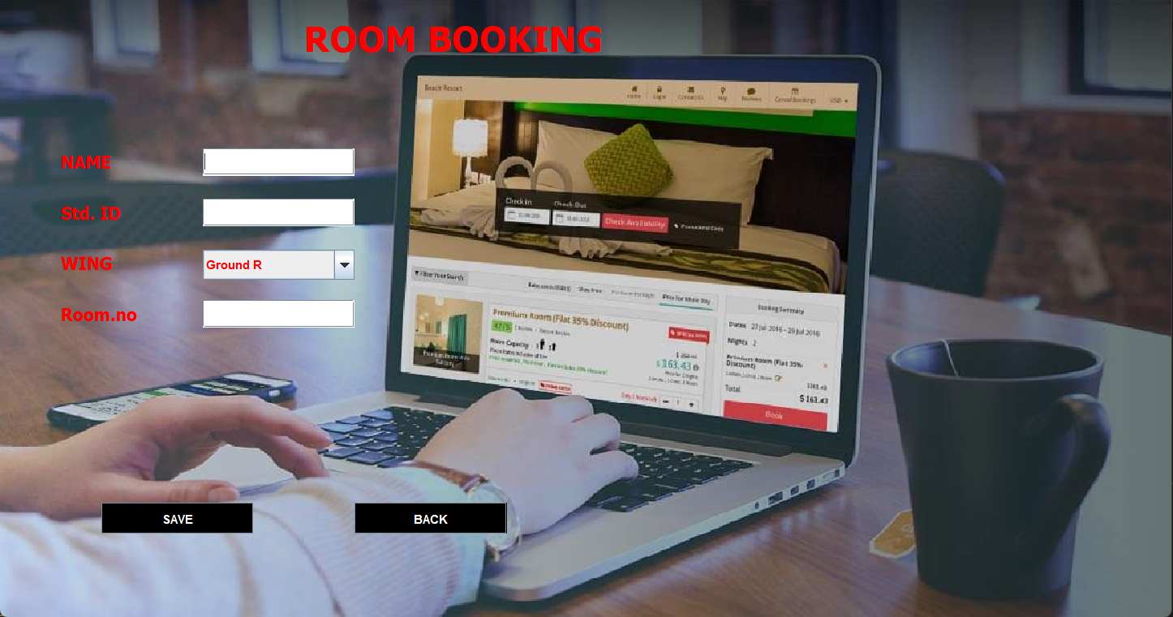
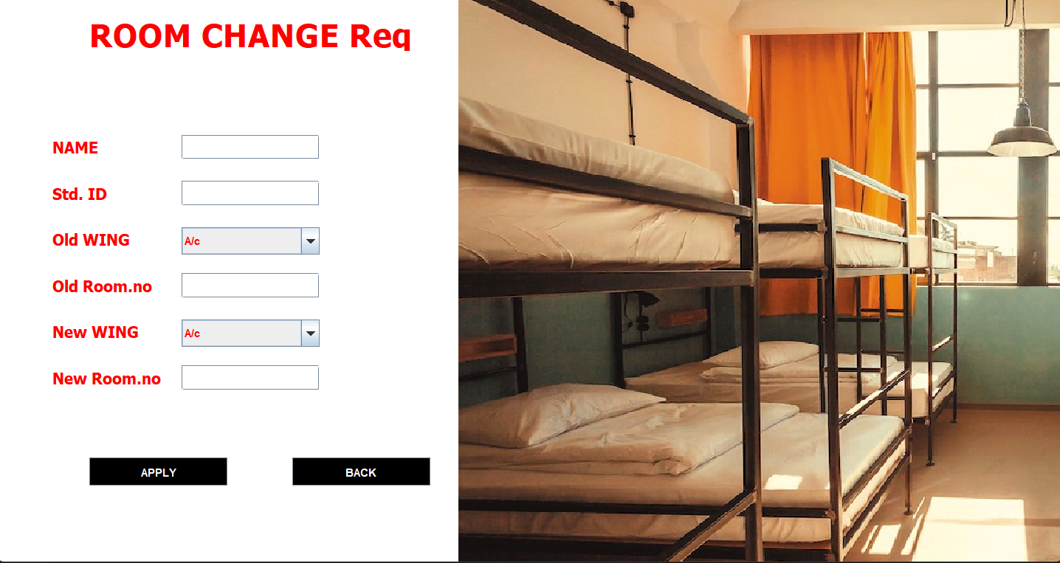

Slide 15
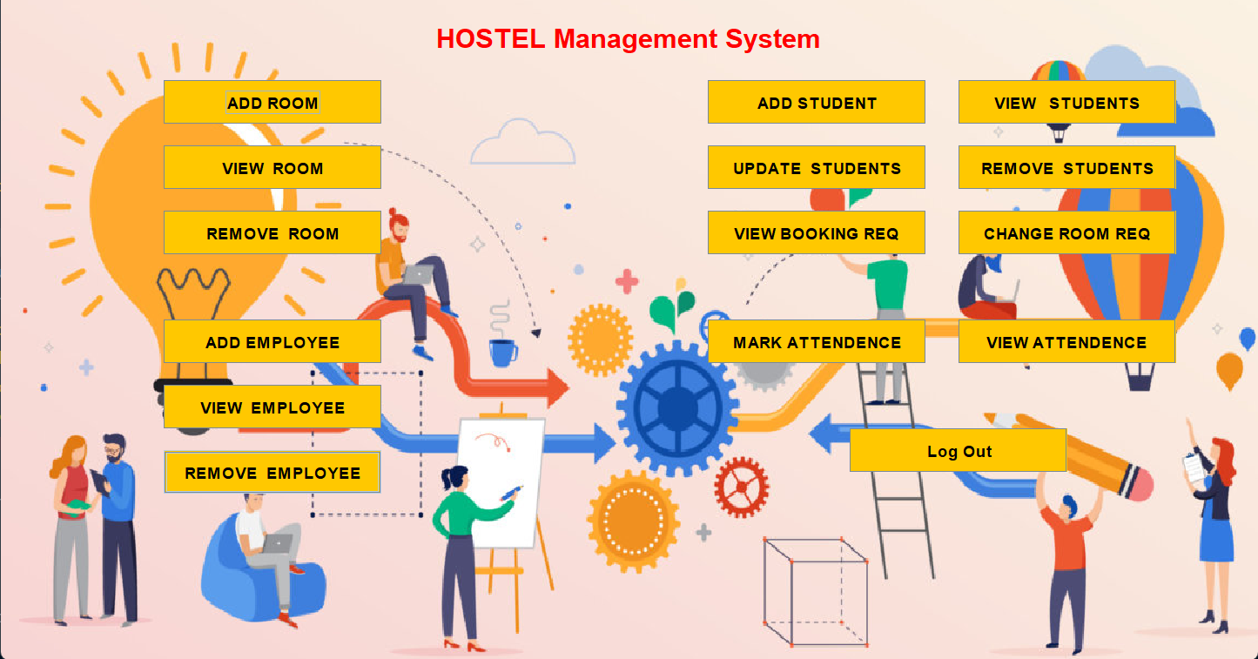

Slide 16
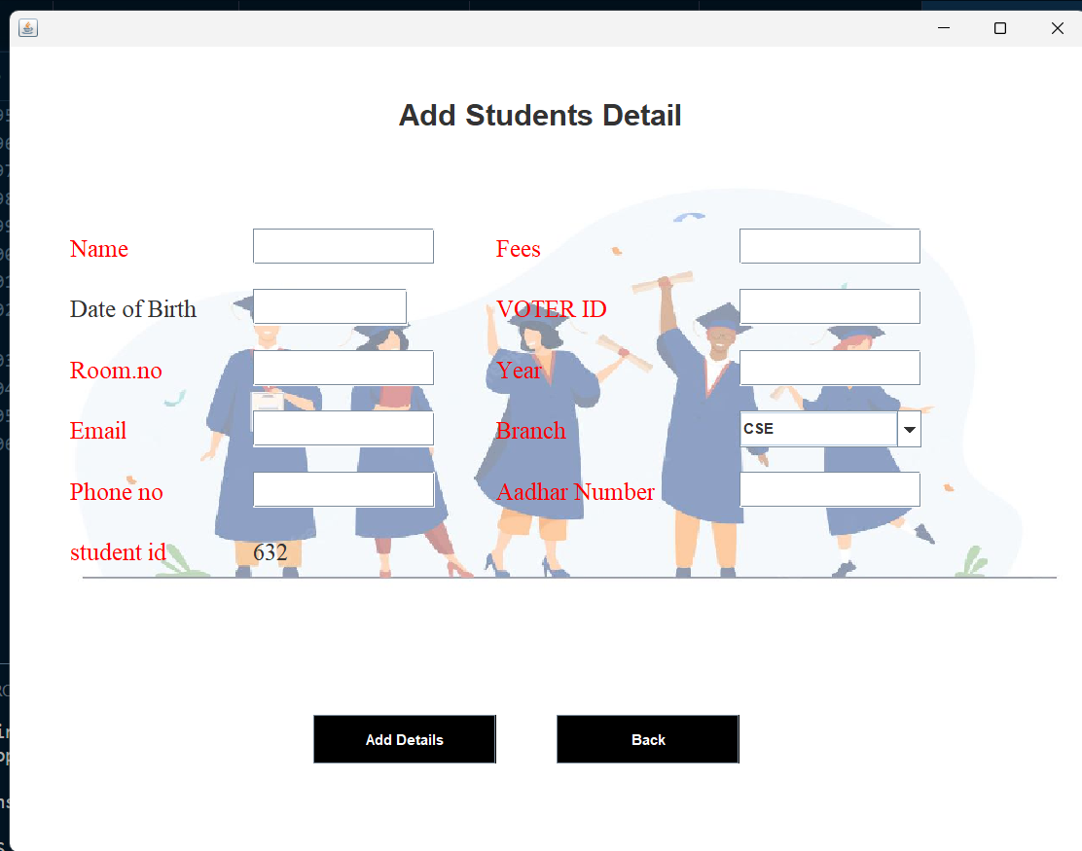
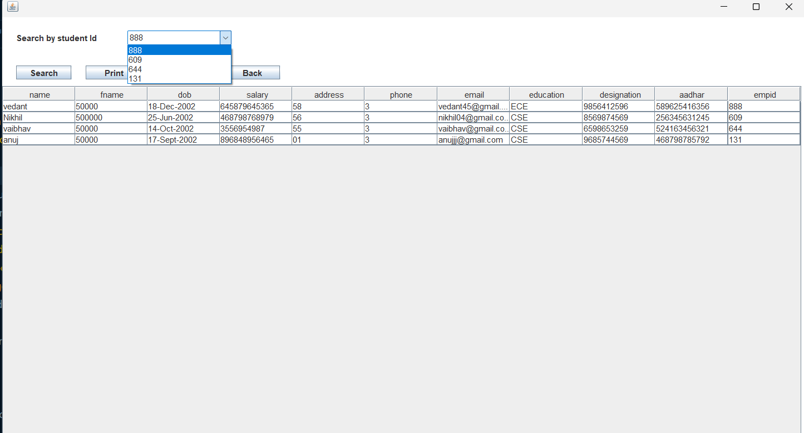
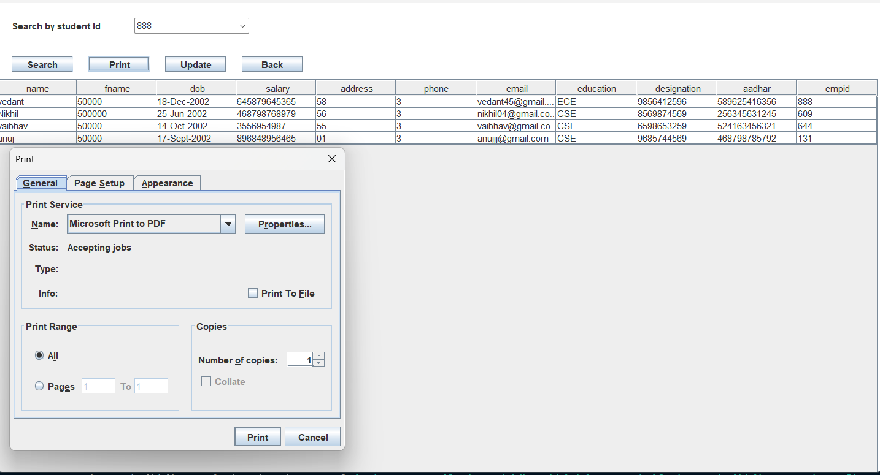
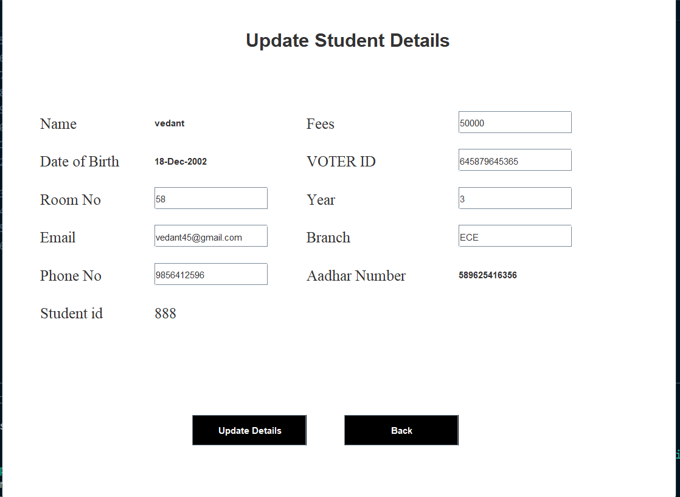

Slide 17

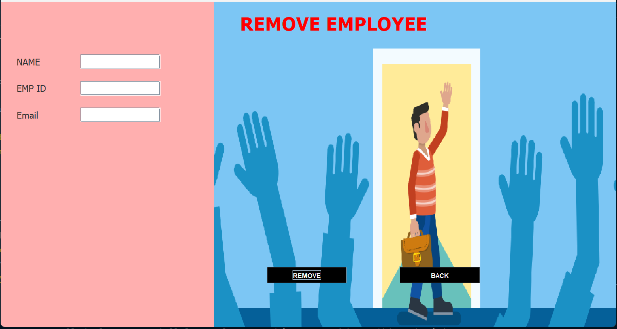
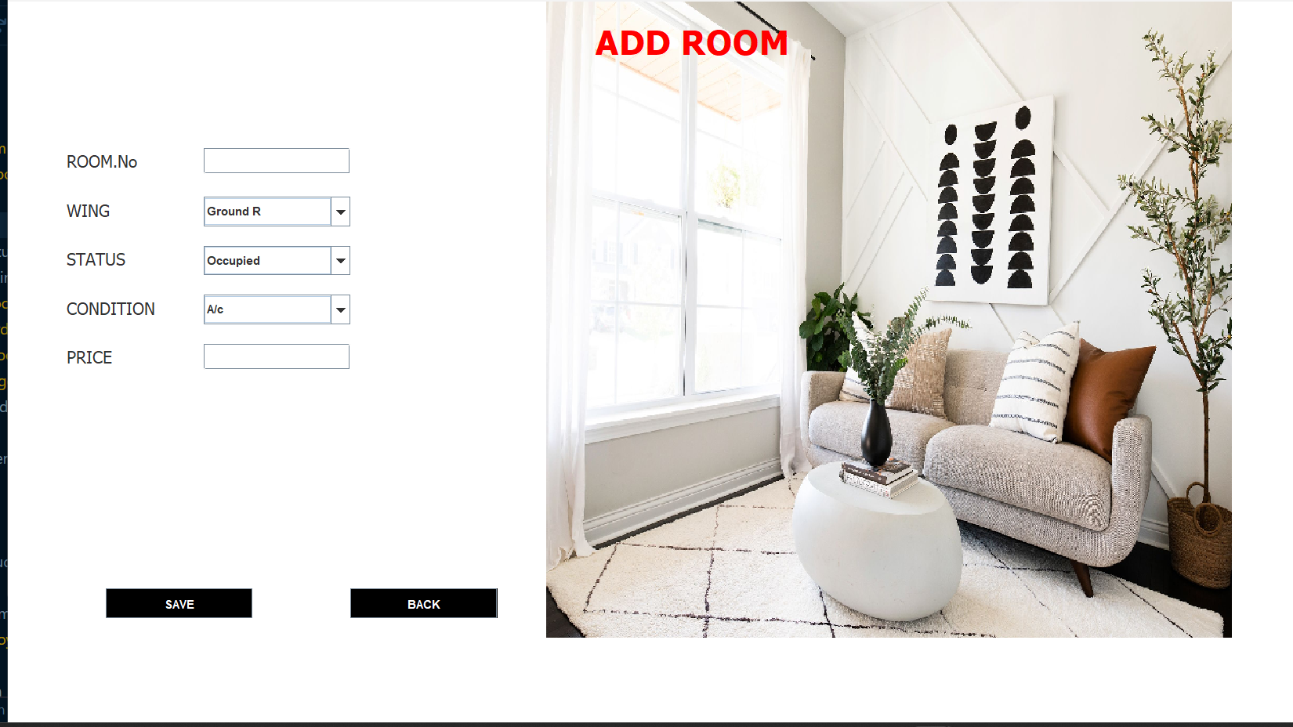
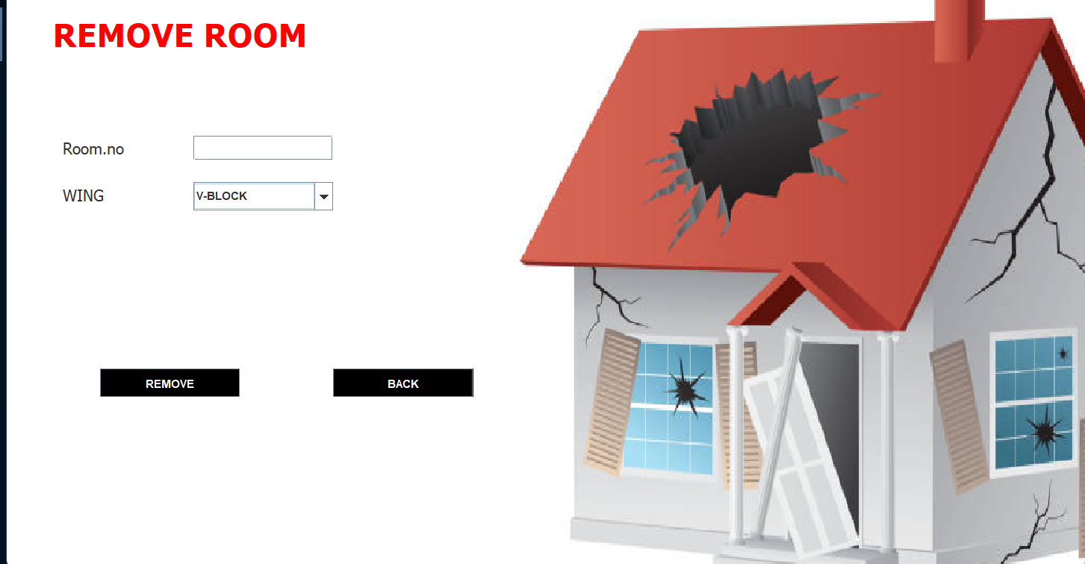

Slide 18

Expect the best, plan for the worst, and prepare to be surprised
“
”
~ Denis Waitley.

Slide 19




Slide 20
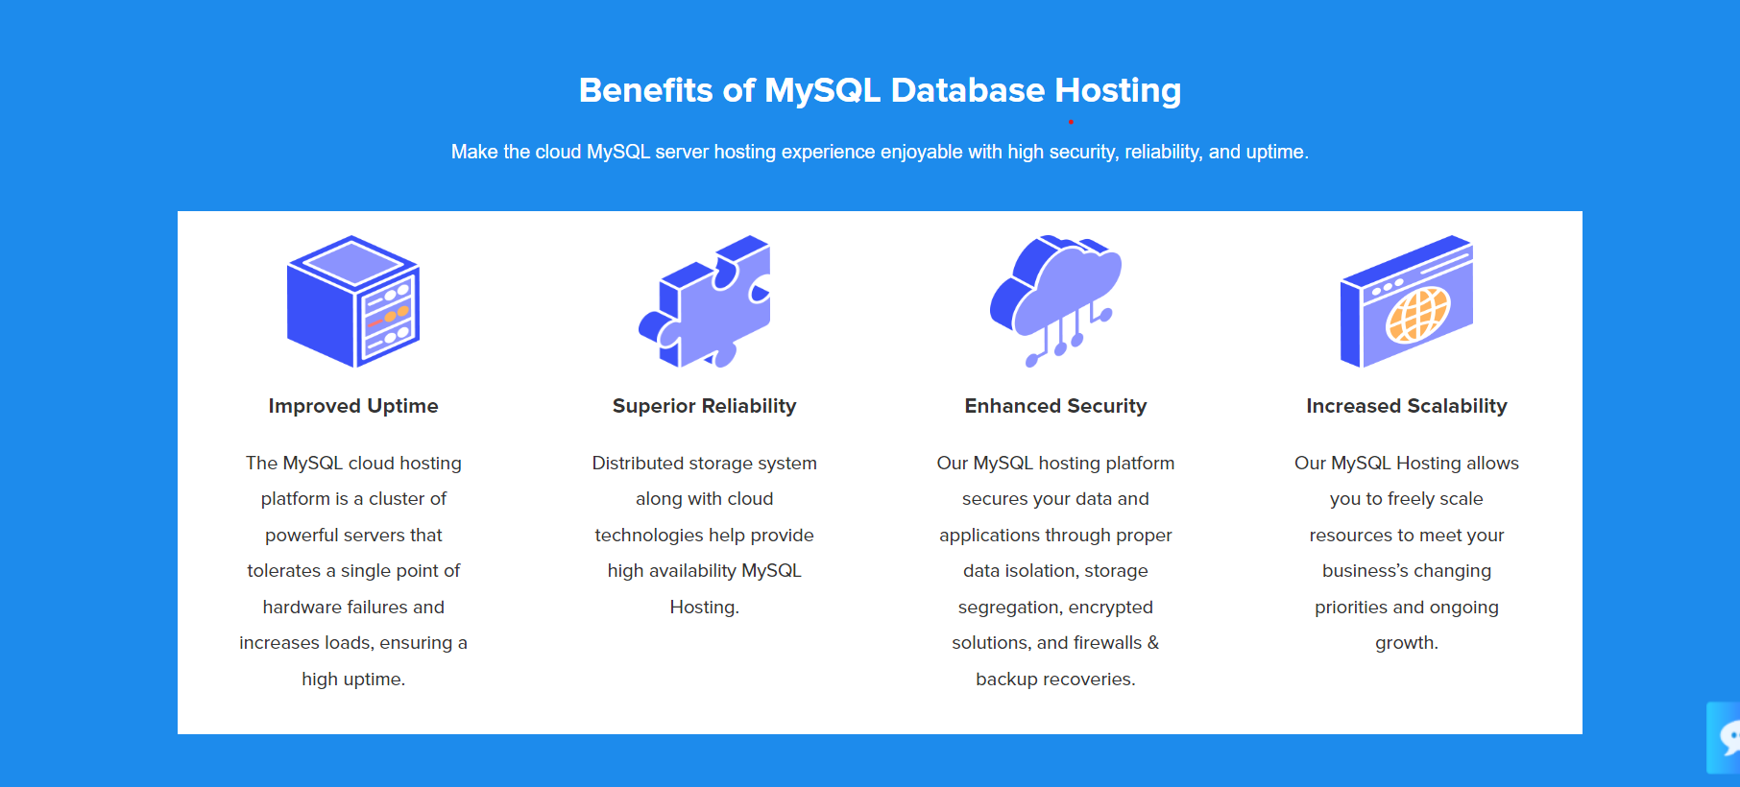

Slide 21
What next?

Slide 22
What next?
Developing Fully functional applications and Installation.

Slide 23


Slide 24
Thank you.

